Slide 1
Producing an Energy Account for Australia
Oslo Group 6, Canberra
May 4, Session 12
Presenter: Eric Morris
Project work: Karen Connaughton, Sean Lawson, Jack Gregory

Slide 2
Sources used in compiling the account
Those used directly for statistical estimates
eg. Physical supply and use data, IGVA data
Those used to build methodologies
eg. Pricing methodology and re-allocation from energy balance

Slide 3
Sources directly used for statistical estimates
Non-ABS
ABARES Australian Energy Statistics
Physical supply and use
ABS sources
Australian System of Nat’l Accounts (ASNA) 5204.0
IGVA
Notes:
ABARES – activity basis energy balance
some differences, eg transport, commercial and services lumped together
ASNA – IGVA used for energy intensity
Both sources allow intensity back-casting to the 1970s
Conversion factors same as ABARES ones

Slide 4
Sources used to build methodologies
Energy, Water and Environment Management Survey (EWES) 4660.0
Survey of Motor Vehicle Use (SMVU) 9208.0
Notes:
Used to create methodologies for converting ABARES data
-EWES used in converting to ANZSIC 06 basis – eg waste services reallocation, splitting commercial and services
-SMVU and EWES for re-allocating transport fuels from activity to ownership basis

Slide 5
Reallocation of transport fuels to ownership basis
Government portion of transport fuels
Survey of Motor Vehicle Usage Survey data
Government Finance Statistics
Energy, Water and Environment Management Survey data
Energy Use in Government Operations (DCCEE)
ABARE-BRS Energy In Australia Table A - ANZSIC 93
Gross Supply and Use tables - ANZSIC 06
First draft
Final Gross Supply and Use tables - ANZSIC 06
Energy, Water and Environment Management Survey data
Conversion from gross supply and use to net energy consumption by industry
National Accounts - Industry Gross Value Added
Energy Intensity measures
Reallocation methodology from ANZSIC 93 to ANZSIC 06
Split of Commercial and Services
ABARE-BRS Energy in Australia Table F

Slide 6
Importance of pricing
Energy a scarce and in demand resource
Increasingly politically contentious issue
Gaps and lack of transparency in available information
Notes:
Strategic energy statistics review notes:
-Critical for policy making regarding supply and demand of energy, efficiency, and competitiveness.
-Lack of transparency in some fuels such as electricity price components and gas contract prices (which we aren’t really addressing here? Maybe with the supply survey?)
-ABS does PPI and CPI
-Variety of other piecemeal sources
-Wide variety of sources, differing quality, cannot compare across fuel types
“Australia does not currently report price or price indices data to the IEA for many liquid fuels, natural gas, coal or electricity, even though this information is requested by the IEA for inclusion in the IEA Energy prices and Taxes Statistics, which is published quarterly.”

Slide 7
Hybrid Energy Use Table example template
 | Coal |  | Natural Gas |  | Petroleum Products |  | Uranium |  | Electricity
 | PJ | $m | PJ | $m | PJ | $m | PJ | $m | PJ | $m
Agriculture, Forestry & Fishing | - | - | - | - | - | - | - | - | - | -
Mining | - | - | - | - | - | - | - | - | - | -
Manufacturing | - | - | - | - | - | - | - | - | - | -
Electricity, Gas, Water & Waste | - | - | - | - | - | - | - | - | - | -
Construction | - | - | - | - | - | - | - | - | - | -
Transport | - | - | - | - | - | - | - | - | - | -
Wholesale & Retail Trade | - | - | - | - | - | - | - | - | - | -
Accommodation | - | - | - | - | - | - | - | - | - | -
Communication | - | - | - | - | - | - | - | - | - | -
Other Commercial and Services | - | - | - | - | - | - | - | - | - | -
Total Industry | - | - | - | - | - | - | - | - | - | -
Residential | - | - | - | - | - | - | - | - | - | -
Inventory Changes | - | - | - | - | - | - | - | - | - | -
Total Domestic | - | - | - | - | - | - | - | - | - | -
Exports | - | - | - | - | - | - | - | - | - | -
Total | - | - | - | - | - | - | - | - | - | -
Notes:
Template of end goal hybrid account (mockup only - room for disaggregation of fuels and industries, obviously)
Question: how to obtain price information for valuing energy for this hybrid account ($m figure represents valuation, not observed expenditure, since not all energy consumption is paid for)
Critical integrity test: implicit prices must be plausible and differences by industry must be credible

Slide 8
Previous method
Quantity from ABARES energy balances
Expenditure from ABS IO tables
Expenditure/Quantity = implicit price
Results – experimental hybrid table for 2004-05, Energy Account 2007 (4604.0)
Notes:
IO tables at the most disaggregated level provide most key energy products in isolation
Confrontation: price information found in public domain – only possible method to validate resultant prices.
Problems:
-matching different sources, questions of coherence (are we comparing like with like?)
-Basis of IO data - not direct observations
-IO framework - uniform price for each commodity throughout intermediate use
-Purpose – used for macro-level modelling of economic relationships, individual cells frequently not robust – 700 000 cells at highest level of detail

Slide 9
Our current attempt
Standard business survey supplement
Energy Water Environment Survey (EWES)
Obtained volume and expenditure
Expenditure/Quantity = implicit price
Gaps filled from other sources or via previous methodology
Notes:
-Result is implicit prices rather than trying to match an expenditure figure to a volume figure from a different source
-ABS control of source, ongoing, means we can refine over time.

Slide 10
Advantages
Robust real-world observations
Directly observed
Entire economy (almost)
All data from same source
Prices differentiated by industry
Notes:
-Timeliness in comparison to IO data (for 2006/7 account we were stuck publishing 2004/5) – about 18 months lag time for this method?
-Respondents did not always report both volume purchased, and expenditure. What does a non-reporting of expenditure represent? Free energy? Self extracted? Respondent doesn’t know? Commercial in confidence?

Slide 11
Limitations
No margins or other price components observed
Reporting burden
Response quality
Notes:
Conceptually, what we have is a valuation rather than expenditure. It also does not depict margins or cost components or rebates or taxes, merely end cost for consuming entities.
Burden - Issues with finding information – as soon as you ask for volume you’re asking them to find additional documentation. Also, other agencies – NGERS etc – also ask for energy information of different types.
Quality – accountants generally responding, sometimes environment officers at larger companies. Not always across things like conversion factors or physical units.
Some fuels can’t be valued by this method of observing market prices (eg bagasse, maybe wood, maybe brown coal)

Slide 12
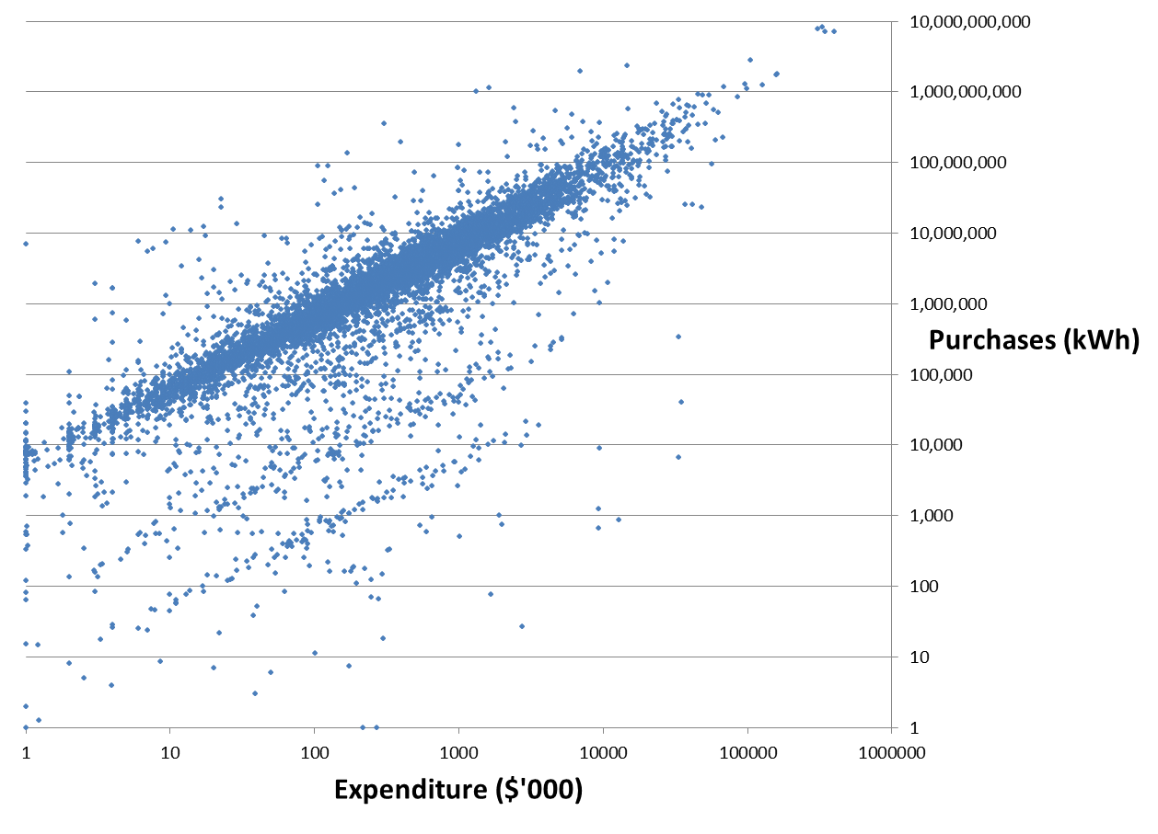
Implicit electricity prices in survey data (Volume vs Expenditure, log scale)
Notes:
This shows reporting quality for electricity – probably the most used by small business and therefore the worst-reported.
Note the order-of-magnitude issues. Values over $1/kwh etc. Produces sample wide bias.
To some extent this lack of cohesion is inevitable when asking for two elements of related data but the question then becomes what was the cause and how to fix – values of over $1/kwh or more simply not credible.
-unit error? dollar error?
-half-arsed estimation by someone who doesn’t know or care?
-different respondents?
-consumption of non-purchased energy or bunkered energy?

Slide 13
Treatment of own use
Some fuels consumed outside the market, especially by large companies
Valuations based on prices from observed purchases, then applied to all consumption
Notes:
High rate of imputation in the dataset – people not reporting both figures had one imputed in most cases (assumption: small business doesn’t know both figures) or was left at zero for some large businesses where it is probably own use/self extracted.
In our case we want to value all energy, so we apply the observed values from units which did buy the product.\
This means our monetary use valuations will be higher in many cases, and the discrepancy with expenditure figures would reflect the extent of own-use etc

Slide 14
What is a price?
Many possible things
Volatility
Contract prices
Is there an actual market?
Notes:
Prices can mean numerical values or indices, can include or exclude various margins, can be official or observed, etc.
What we have in our case is an effective price (gross?) for each product, reflecting all supply charges and so forth, over the course of the reference year, as opposed to a unit price.
Some complications:
Volatility – market price changes daily for some fuels. Not a huge obstacle, and actually this observation method probably simplifies it versus attempting to use daily published prices available elsewhere.
Contract prices and bulk rates – large quantity, long term contracts do not reflect current market value, etc.
(Best example is the export price of commodities rising rapidly due to coal contracts being renegotiated during the reference year. Some respondents would be reflecting that, some not, and to varying extents)
Market – assumption we must make is the valuations observed are appropriate market value for non-market consumption, won’t always be true Examples:
-brown coal can’t be moved easily
-natural gas pipelines result in varying prices in different places depending on source
-own-use or self-extracted energy onsite would not have retail, transport or wholesale margins

Slide 15
Questions/ Discussion points
Other countries experiences?
Non-market energy
Use of survey vehicles
What assumptions are made and are they appropriate?
Notes:
Other experiences? – eg valuation of inputs into renewable energy? (presently only exists in this table as electricity)
Survey vehicle method – appropriate? Are there better ones?
Assumptions? Is the valuation of non-market energy the right approach?

